Slide 1


Employee Travel Booking Project
Employee Travel Booking Application allows Employees to place requests for booking business travel tickets.
Presented By
Akansha Bhagat (220462)

Slide 2


INDEX
Introduction
Flow Chart
Console Screens
Project Structure
Project Features
Project Overview
Conclusion

Slide 3
Problem Statement
To Develop an Employee Travel Booking Application which will manage Employees and there Travel Requests.
Develop an user friendly application which will provide functionality to manage employees and travel booking requests.

Slide 4

Introduction
In current corporate world, Employees are often required to travel to Domestic as well as international locations based on business requirements.
This application “Employee Travel Booking Application” will help employees to raise or submit a ticket for travelling to the required location.
Process of raising or placing a travel requests –
1. Employees will raise or place the travel request.
Manager can approve, reject the request.
Once manager approves the request travel agent will confirm the travel or can make the status as Bookings not available.

Slide 5

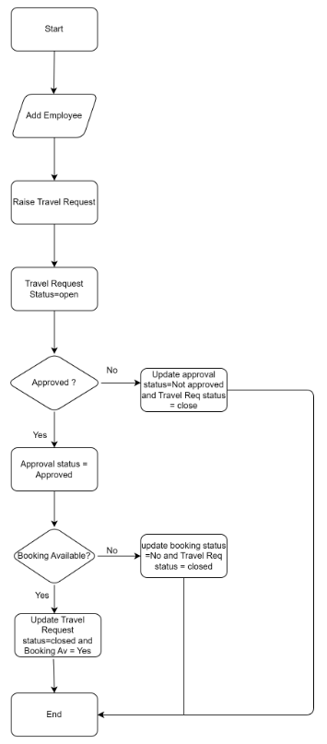
Flow Chart

Slide 6
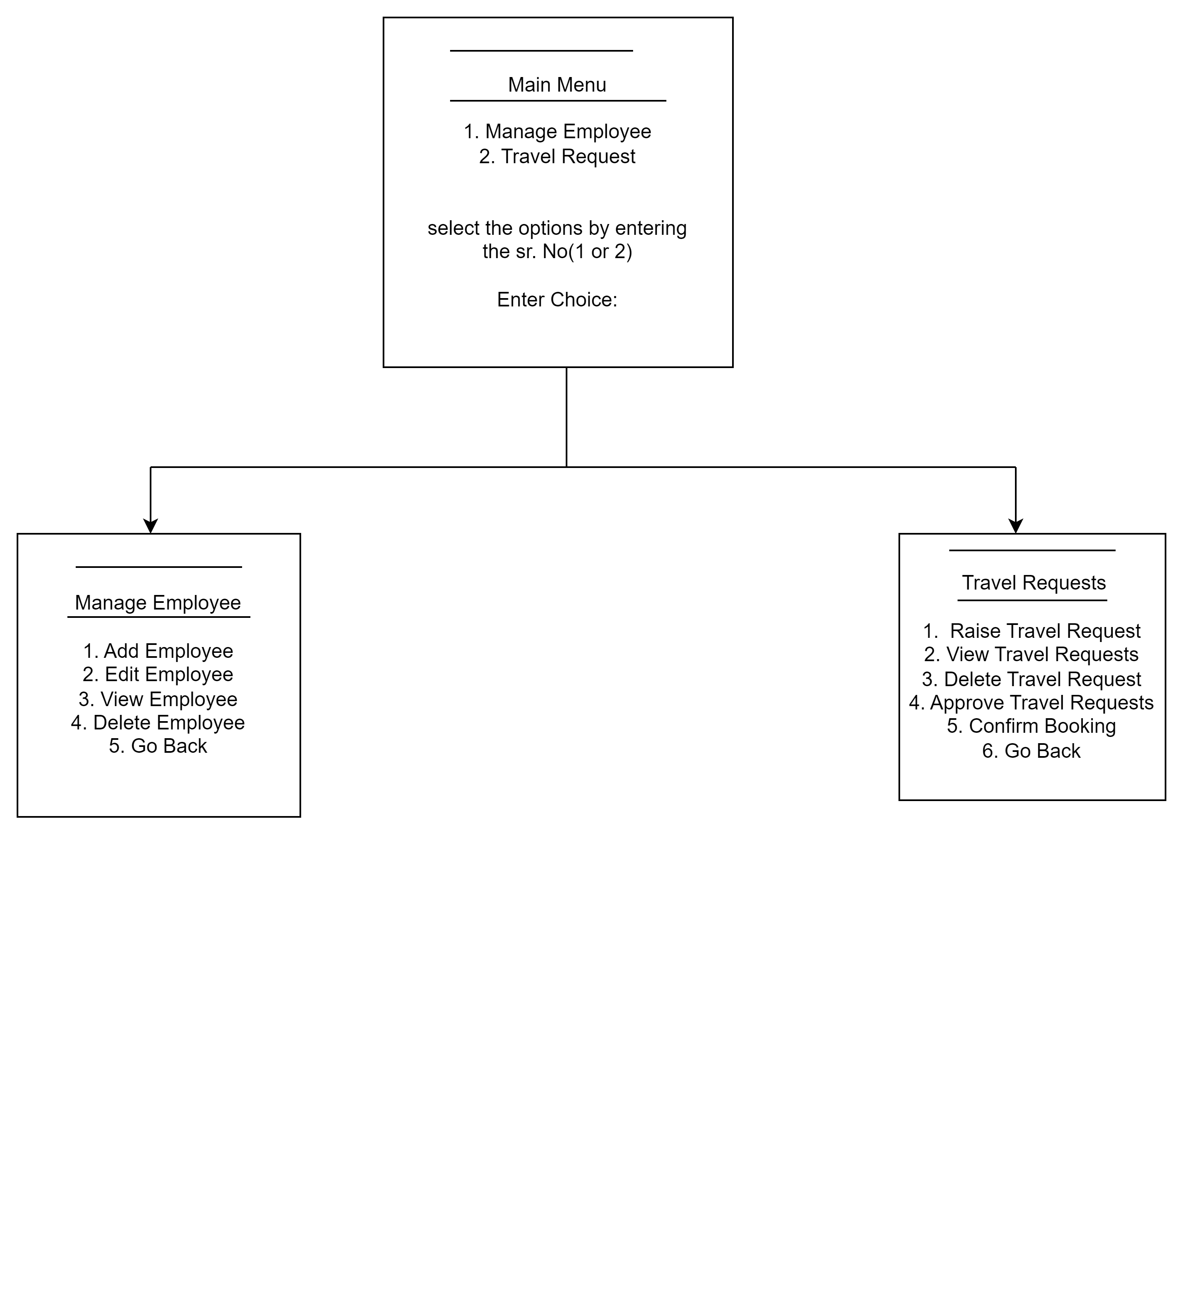
Console Screens

Slide 7

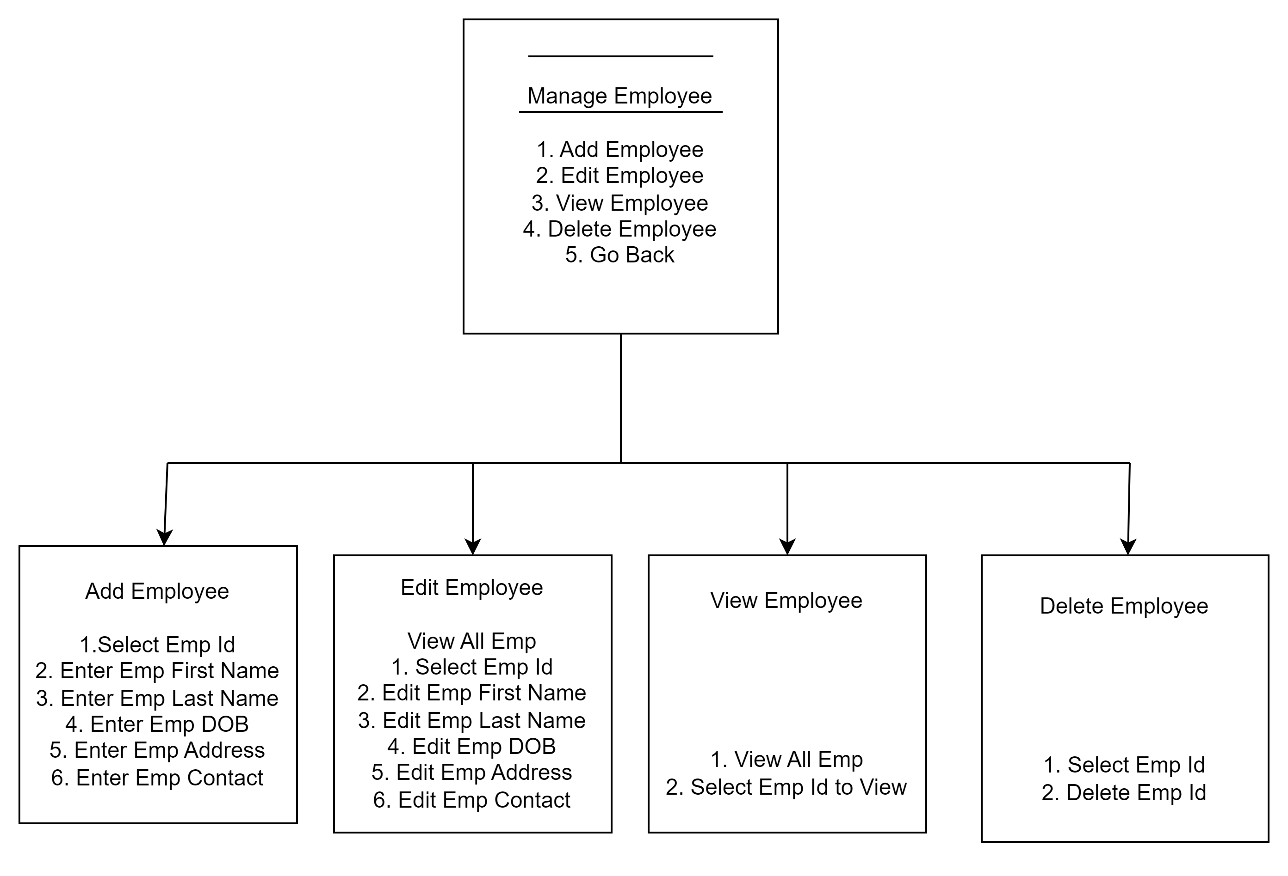
Console Screens

Slide 8
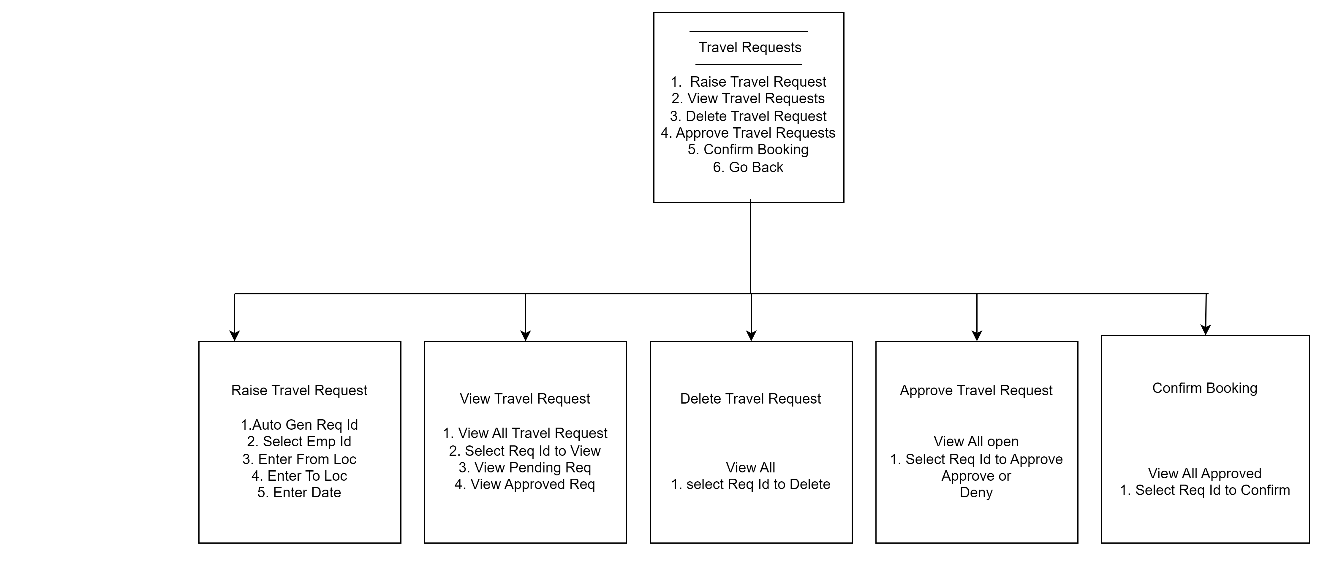
Console Screens

Slide 9

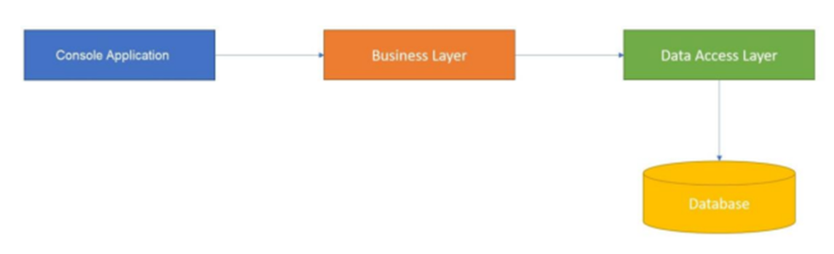
PROJECT STRUCTURE
User Interface
Business Logic Layer (BAL)
Data Access Layer (DAL)
Database

Slide 10

The system allow the following functionality:
Add Employee
View Employee
Edit Employee
Delete Employee
Raise new Travel Request
View All Travel Requests
Edit Travel Request
Delete Travel Request
Approve or Reject the travel request raised by Employee
After Approval Confirm Booking or Not Available and Change Request Status

Slide 11

Software Requirements
Development Components -
.NET Framework
C# Programming Language
Visual Studio 2022
Class Library
Console Applications
2. Design Tools -
Draw.io
Development Tools –
Git Hub

Slide 12
Project Features and Functionality
C# .NET Programming Language is used for development.
Data Security/Privacy.
Interface Concept Used for Flexibility and reusability of code.
Provided Multiple Views option.
LINQ used to directly fetch from DAL
When Travel Request is Approved & Confirmed or Approved but Not available then close the Request Status.
Memory Utilized by creating static objects.
List Collections are used.

Slide 13
Project Overview
1
Efficient Travel Management
Streamline the process of booking and managing employee travel.
2
Functionality
User can Raise a Trave Request then approve and confirm the Booking and view the Travel Request.
3
Code Reusability/ Date Security
By using Interfaces , Class Library and different Layers. By using Interfaces and Classes and different Layers. using Class Model and Layers Security is Achieved.

Slide 14

Conclusion
This Project Provides the functionality of Employee Travel Booking Application such as raising travel request and approving, Booking request and at the end changing Request status to Close , with user friendly interface.
Git Hub Link –
https://github.com/akanshabhagat/Employee-Travel-Booking-Project/tree/master

Slide 15
THANK YOU !!

